Slide 1
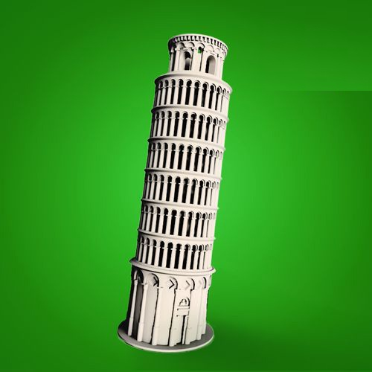
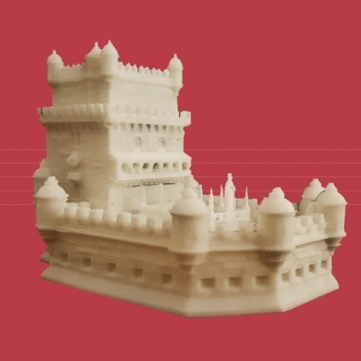
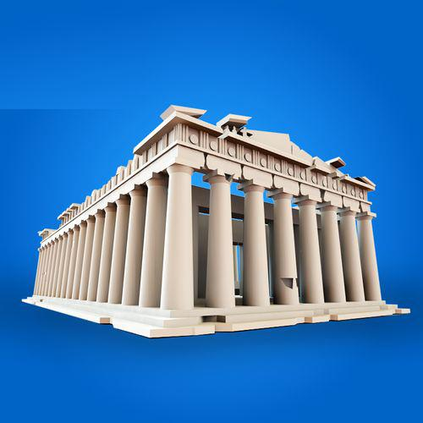
Cultural heritage Monuments Analysis

Slide 2
Outline
Learning Objective
Definition of Monument’s Analysis
Selected Monuments of Greece, Italy & Portugal
Points to Remember
Activities
Videos

Slide 3
Learning Objective
At the end of this course, students will get to
Know which are the factors that define the precious value of a monument
Learn when and why famous monuments were created
They will be able to:
Compare different types of monuments of their region
Describe characteristic monuments of their region (6-11)
Understand the role some key monuments played in their region’s history (6-11)

Slide 4
Definition of Monument’s Analysis
Changes of major historic/cultural events over time
History
Function-users
Context 🡪 location, relation with other buildings, relation with the sea/river/mountain etc
Architectural features 🡪 columns, walls, doors, roof etc
Form 🡪 shapes of elements
Set-up 🡪 spaces of the building, like stoa, pronaos, naos
Decoration 🡪 location/form/theme
Meaning/values/symbolism
https://artsandculture.google.com/ 🡪 Search for Belem Tower, Colosseum and Acropolis

Slide 5
Definition of Monument’s Analysis
To analyze a monument reply to the following questions:
Which monument is this?
When and who created this monument?
What is it?
What did its purpose seem to be?
Where is it?
What is around it?
What does it look like?
Which are the main elements that make the building important?
What story does the monument tell us?
What goals might this monument reflect?
History
Function
Context
Form & Architecture
Symbolism

Slide 6
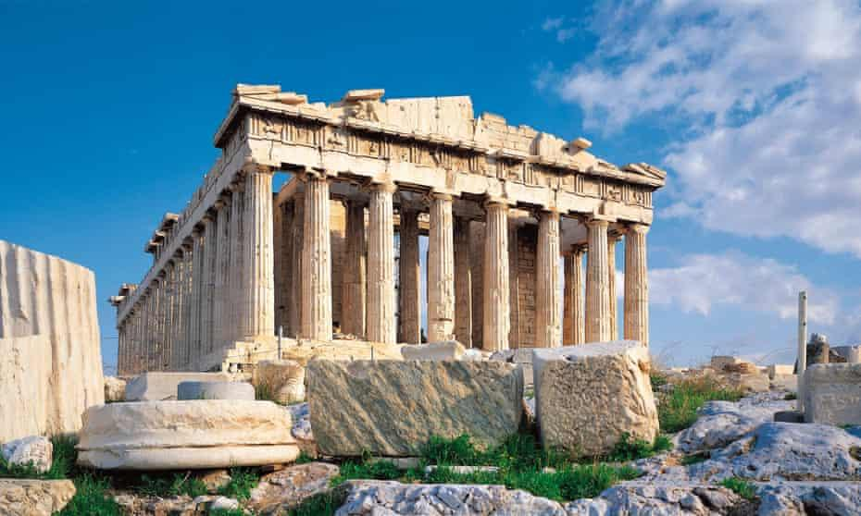
Selected Monument for Greece
Acropolis,
Athens
https://www.youtube.com/watch?v=aGitmYl6U90&t=3s
https://www.theguardian.com/world/2019/jun/08/acropolis-museum-archaeology-daily-lives-ancient-greeks

Slide 7
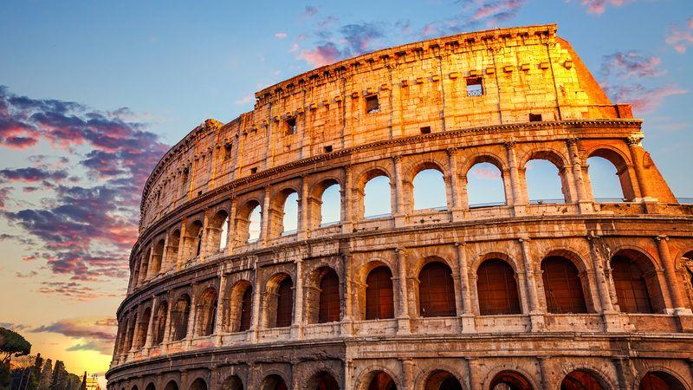
Selected Monument for Italy
Colosseum,
Rome
https://www.unesco.org/archives/multimedia/document-1058
https://www.britannica.com/place/Rome/The-Colosseum-and-the-Arch-of-Constantine

Slide 8
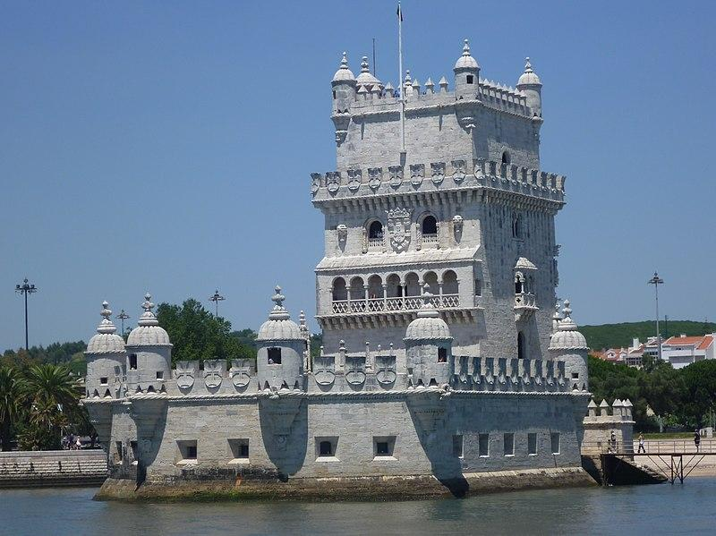
Selected Monument for Portugal
Belem Tower,
Lisbon
https://www.youtube.com/watch?v=uD6igDRWpVo
https://en.wikipedia.org/wiki/Bel%C3%A9m_(Lisbon)#/media/File:Bel%C3%A9m_Tower_-_Lisbon_(cropped).jpg

Slide 9
REMEMBER
Τo understand and appreciate a monument I must first be able to read its history in its individual elements
The factors that characterize each monument refer to its history, functionality, morphology, environment, decoration and symbolism

Slide 10
ACTIVITY 1
KINDERGARTEN & PRIMARY SCHOOL
Puzzle Game (for morphology & architecture)
To complete the puzzle (also at cards’ backside)
To recognize the monument
To describe its characteristics
To discuss the history
TIP: For 3D printing integration
Extruded puzzle pieces
https://www.thingiverse.com/thing:357444

Slide 11
ACTIVITY 2
KINDERGARTEN & PRIMARY SCHOOL
Paint App (for functionality)
To learn different building parts of monuments
Open the file of the façade of the selected monument in Paint
Ask pupils to paint a different building part (e.g. door/windows/dome)
Nea Moni Monastery, Chios

Slide 12
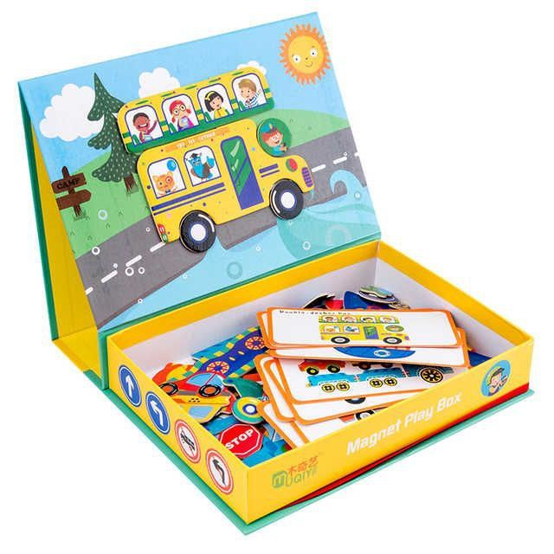
ACTIVITY 3
KINDERGARTEN & PRIMARY SCHOOL
Magnet Board (for architecture)
To select a monument from the card pack
I discuss the elements of which it consists
To print the monument parts on magnetic paper
To cut the parts’ outline
To compose the monument onto the metallic board

Slide 13
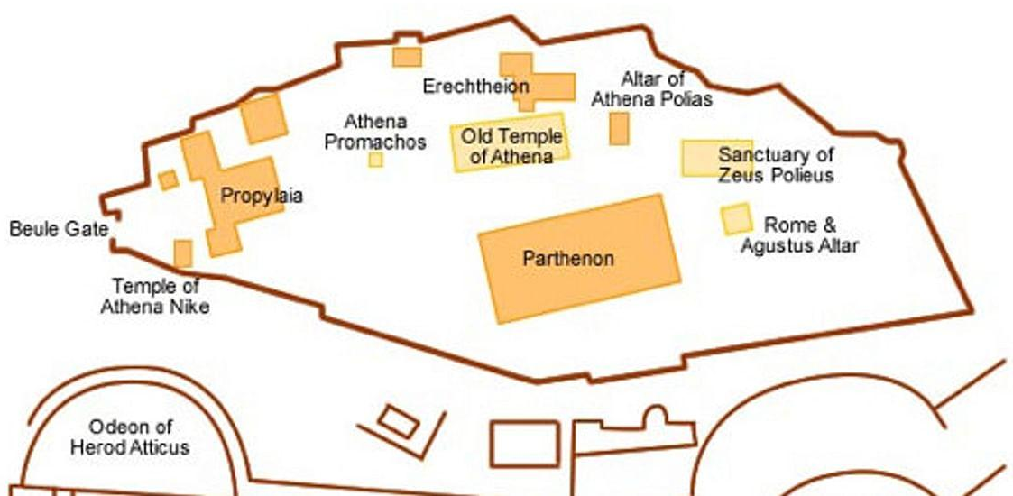
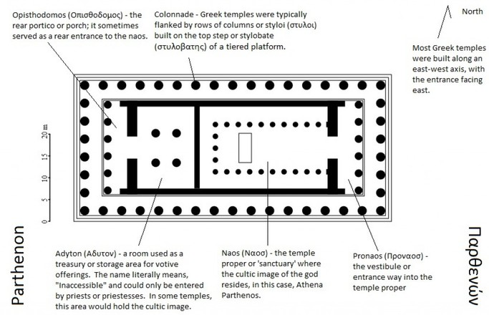
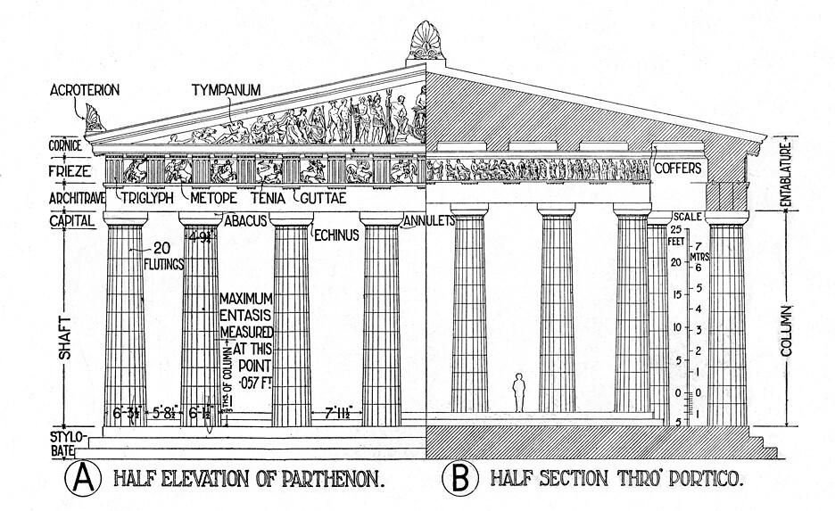
ACTIVITY 4
KINDERGARTEN & PRIMARY SCHOOL
3D pens drawings (for set-up & forms & decoration)
To draw the outline and the main elements of monuments
To recognize the shapes and discuss about the architectural elements & decoration
Ask pupils to paint a different building part (e.g. Column /metopes /pediment)

Slide 14
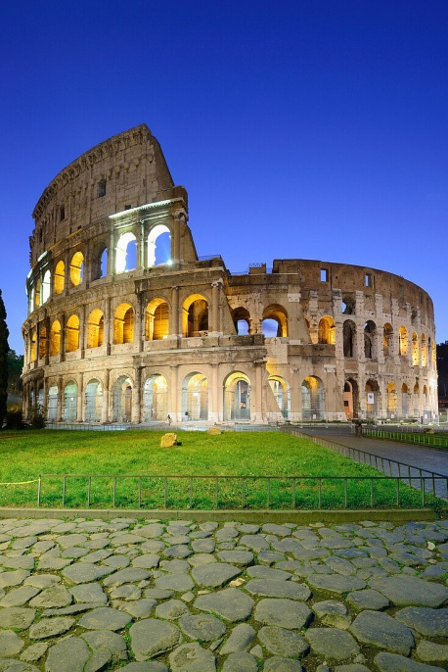
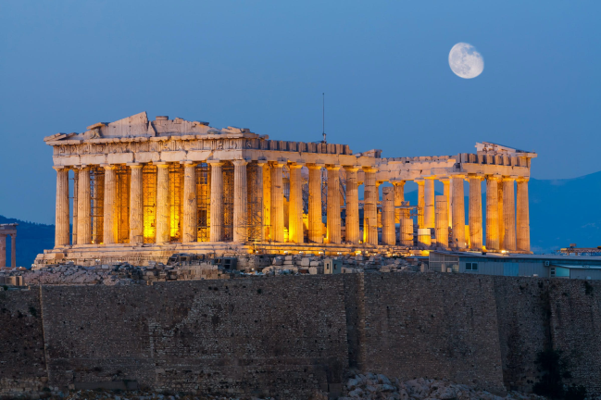
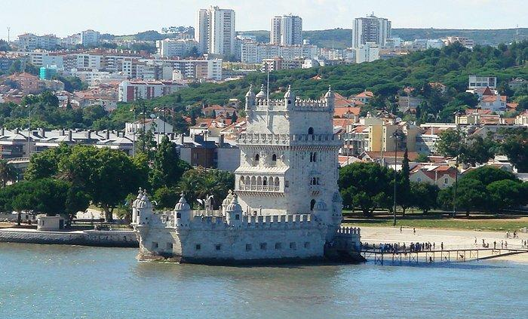
ACTIVITY 5
KINDERGARTEN & PRIMARY SCHOOL
Knowledge Game (for general analysis)
Separate the students into small groups (2-4 persons), make them sit in a circle and place in the middle one of the (printed) pictures above/ in case of only 1 teacher avoid separation in groups
Ask the following questions:
What is this building?
Who may work in this?
Is this building very old/old/new: Why?
Describe the surrounding environment where this building is located. Is it in the jungle? The desert? The mountains?
Show a video and make a short discussion about the history of each building

Slide 15
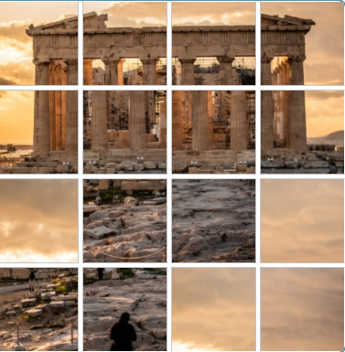
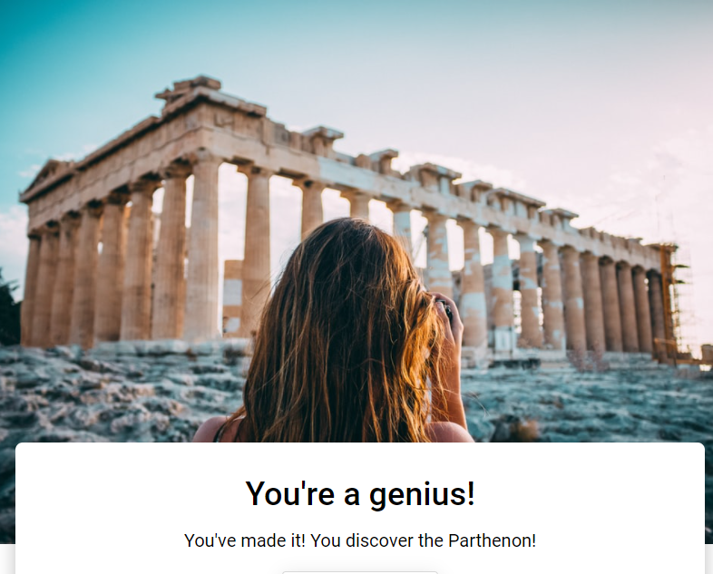
ACTIVITY 6
KINDERGARTEN & PRIMARY SCHOOL
Digital Puzzle
https://interacty.me/projects/9dd7.28745e4058d2

Slide 16
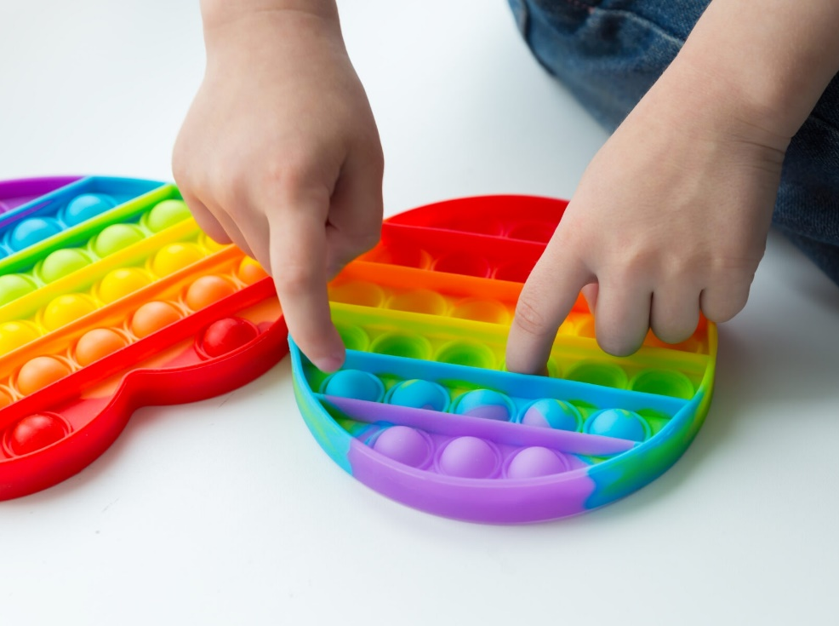
ACTIVITY 7
KINDERGARTEN & PRIMARY SCHOOL
Pop-It Toy (for set-up & forms)
To discuss the basic elements of each monument
To print the monuments outline sheets
To 3D print 2 rectangular pop-it toys
To divide pupils into 2 groups
To select a monument for each group
1st group to make close-ended questions (with yes or no possible answer)
2nd group to form gradually the monument (if positive answer) using a game die
GOAL: To recognize first the selected monument

Slide 17
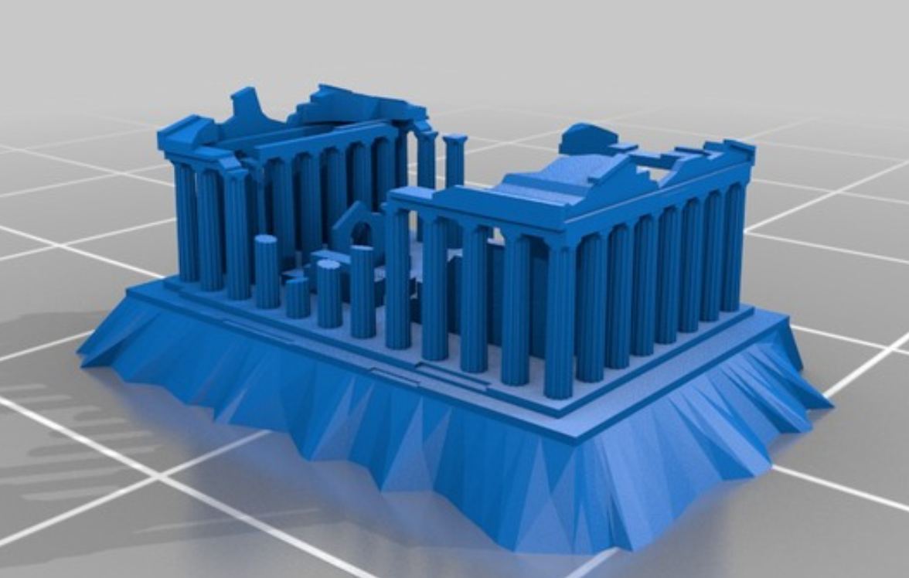
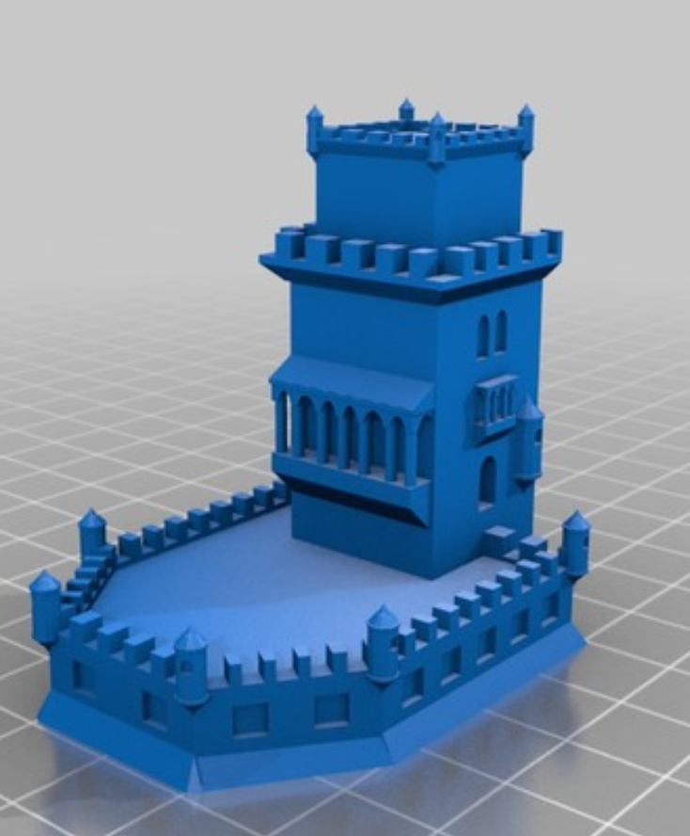
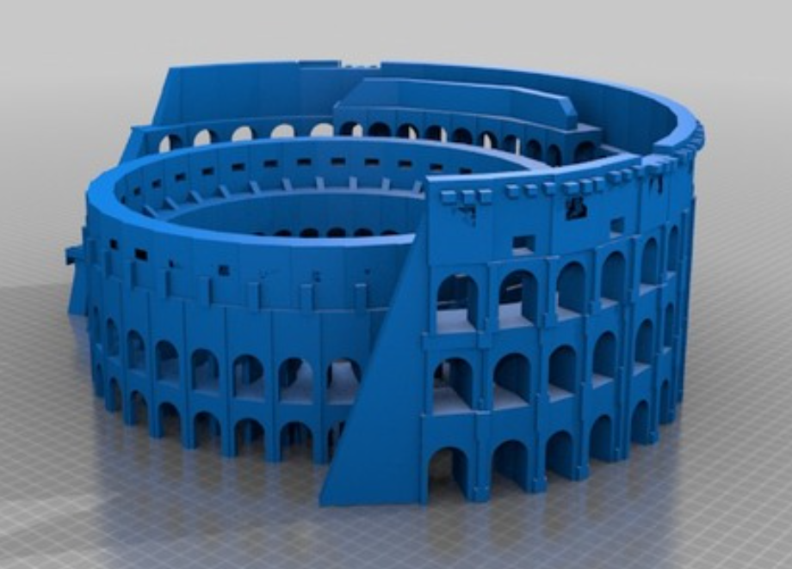
PRINT
KINDERGARTEN & PRIMARY SCHOOL
Print the selected monuments
colosseum.stl.download
Ruins.stl
All .stl files at folder “O2_ L.4-5”
torre_de_belem

Slide 18
Videos
https://www.youtube.com/watch?v=PWPCZ1UjYmI&t=185s
https://www.youtube.com/watch?v=aMCwLHE1Cuw

